Slide 1
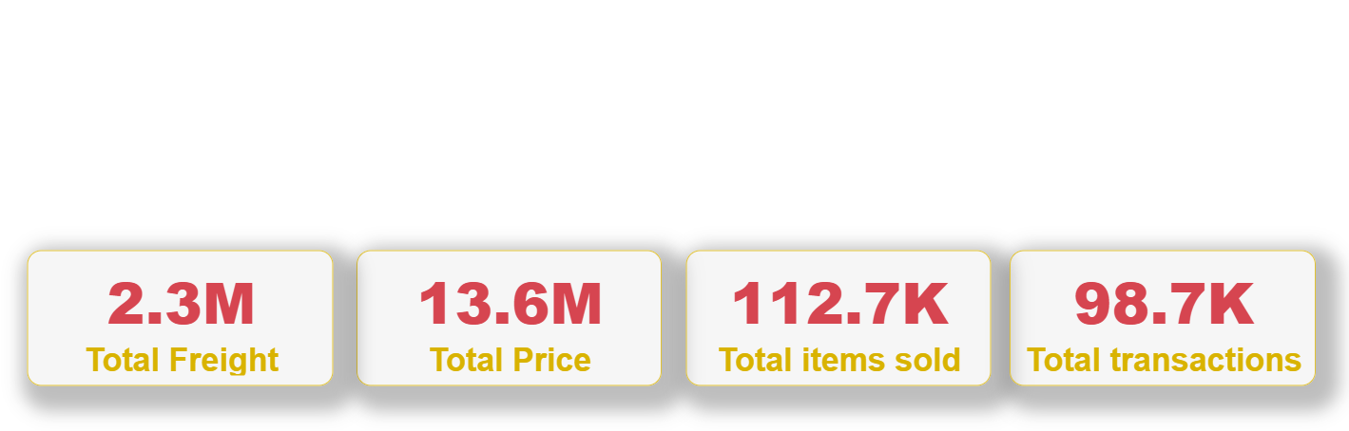

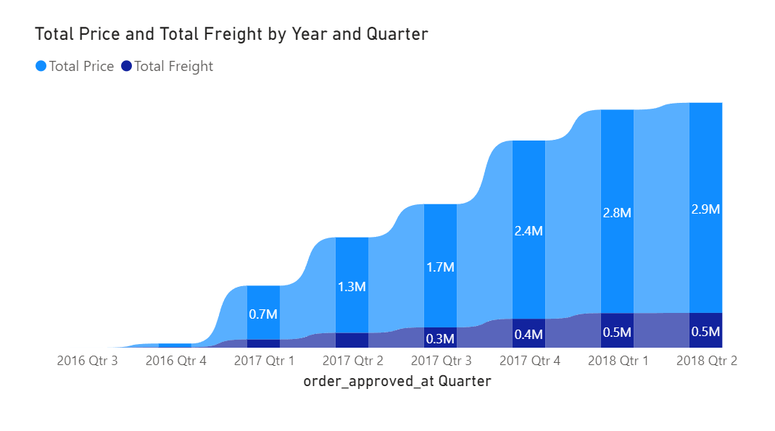
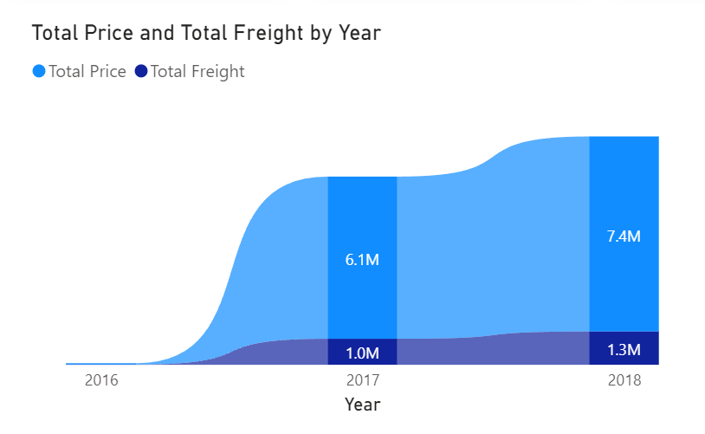
Overview
Transactions up to Sep’18

Slide 2
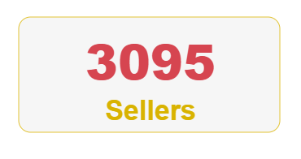
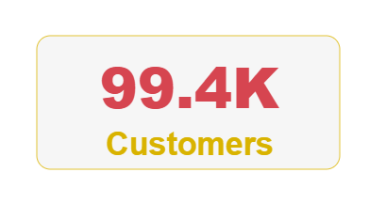
Seller & Buyer Profile
>90% of sellers come from top 5 states
Sao Paolo (60%)
Parana
Santa Catarina
Minas Geras
Rio de Janeiro
The same group also accounts for 92% of total transaction value
No top earner individually accounts for more than 2% of total sales
Top 5 states are home to 77% of buyers and account for 74% of purchase value

Slide 3
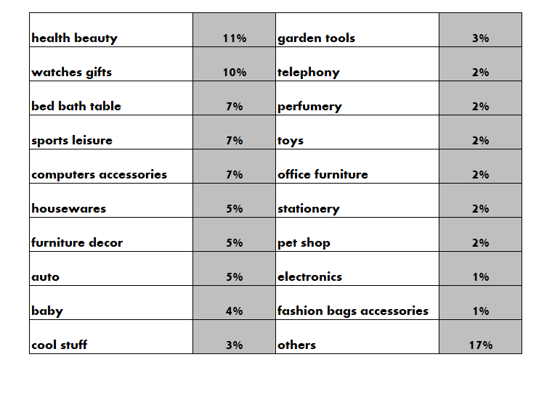
Deep dive Top 20 categories
Top 20 categories make up >85% of orders and transactions value
The list remains almost the same in 2017 & 2018, with only the exception of
construction_tools making the list in 2018 & consoles game dropping out
*category rank and percentage as at 2018

Slide 4
Deep dive Top 20 categories
Out of top 20 categories
Electronics display the fastest YoY growth* ( 52%)
On the other spectrum, toys has the steepest decline ( 54%)
Categories concentration
Office furniture revenue is highly concentrated on few sellers
Health beauty revenue is scattered across all sellers
*growth is defined as the change in category weight over 2 years period

Slide 5
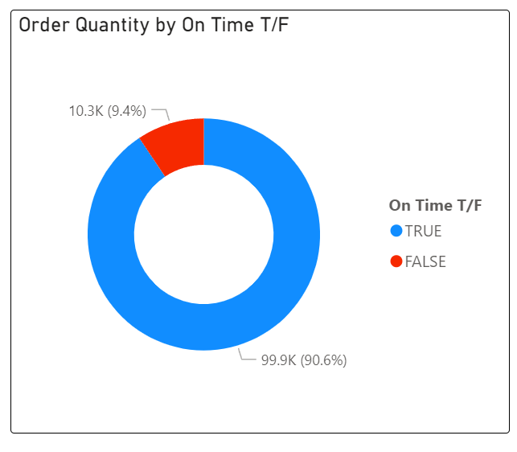
Deep dive Delivery Timeframe
Out of the orders that have been delivered, 90.6% was on time and 9.4% was late
Out of the top 20 categories, Electronics has highest percentage of being late (11.0%), Fashion bags accessories have the lowest (7.4%)

Slide 6
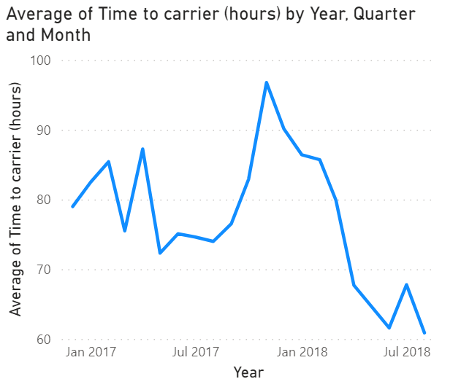
Deep dive Delivery Timeframe
Late orders take an average of 6 days to get to the carrier, while on-time orders only take 3 days
There has been a spike in average time to carrier approaching year end in 2017; however, it has been gradually reducing since then, with the exception of July 2018

Slide 7
Deep dive Photo Attachment
Within the top 20 categories, 48% of products have more than one photos listing and 52% of products have only one.
Health Beauty & Bed Bath Table are two categories that stand out: products with more than one photo have more than 4x chance of getting sold compared to those with only one photo.

Slide 8
Recommendations
Establish connection with brands (as a new avenue) in fast growing categories by driving traffic to them
Execute policies to encourage more sellers to highly concentrated categories (ie office furniture, furniture décor, etc…)
Continue to reduce time to carrier/ have special arrangements ahead of peak times (Christmas)
Increase minimum of photos required for listing within categories where number of photos have high correlation with high sales

Slide 9
Further Analysis
User ID that can capture rate of returning customers
Share of buying interstate vs buying intrastate
Correlation between package size & time to delivery
User behaviour analysis after encountering a negative experience (ie leave less than 3 star review)

